Slide 1



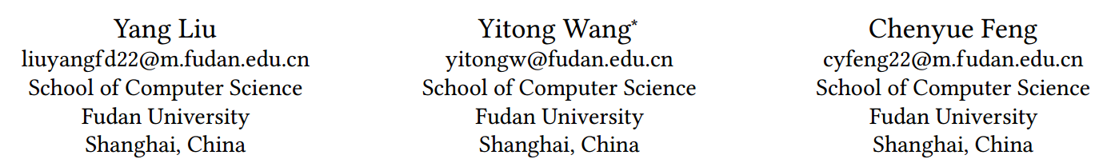





Chongqing University of Technology
ATAI
Advanced Technique of Artificial Intelligence
Chongqing University of Technology
UniRec: A Dual Enhancement of Uniformity and Frequency in Sequential Recommendations
Code：https://github.com/Linxi000/UniRec
2024.10.10 • ChongQing
—— CIKM 2024
Reported by Peng Shan

Slide 2
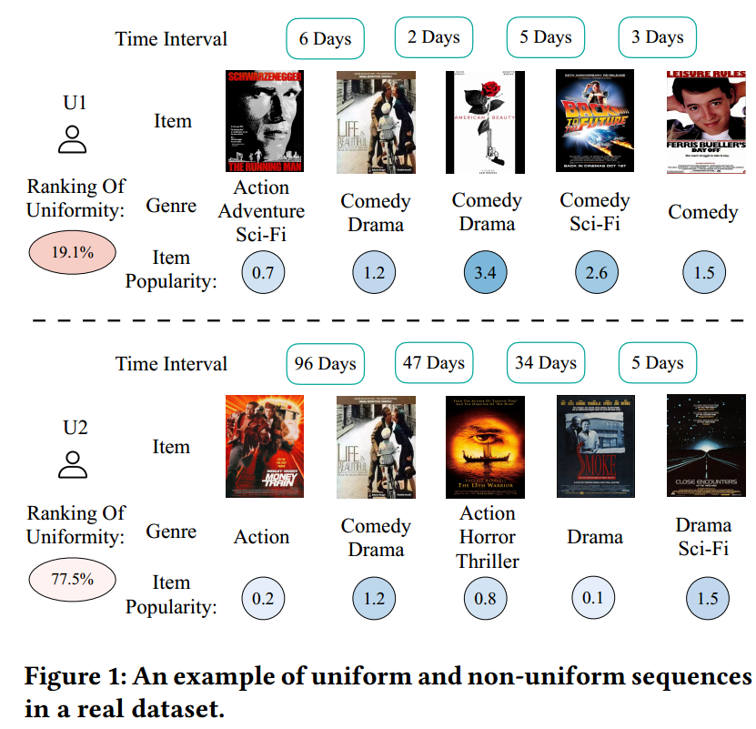
Motivation
(1) Current approaches primarily focus on modeling explicit timestamps or capturing cyclic patterns, but they often overlook time intervals, which reveal user characteristics and convey critical information within user interaction sequences.
(2) Additionally, the effectiveness of a model in capturing item characteristics is influenced by the frequency of these items.

Slide 3
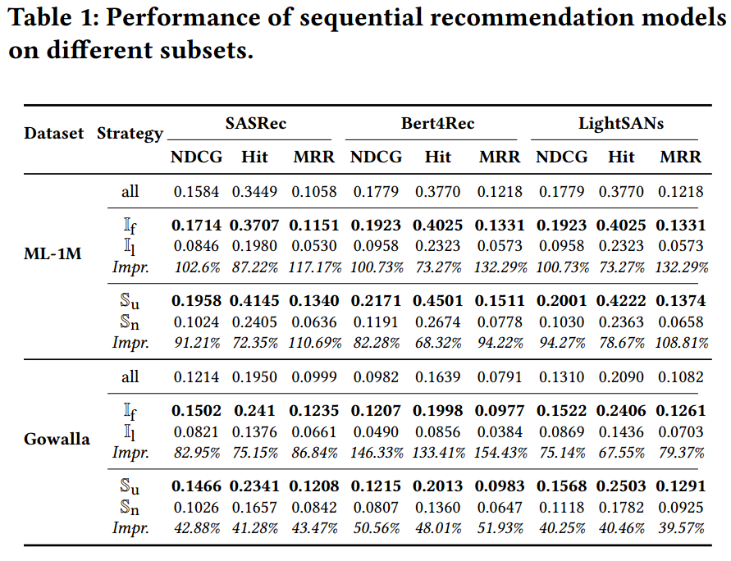
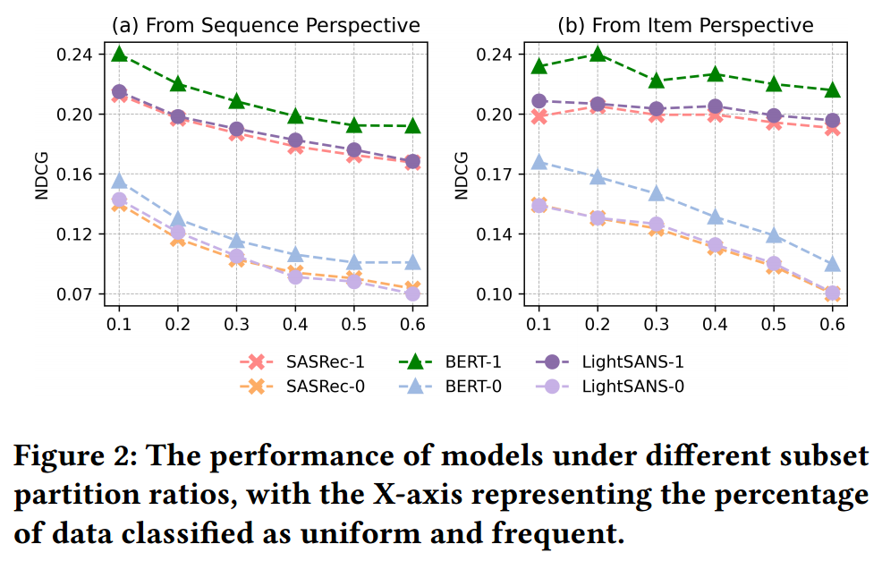
Motivation

Slide 4
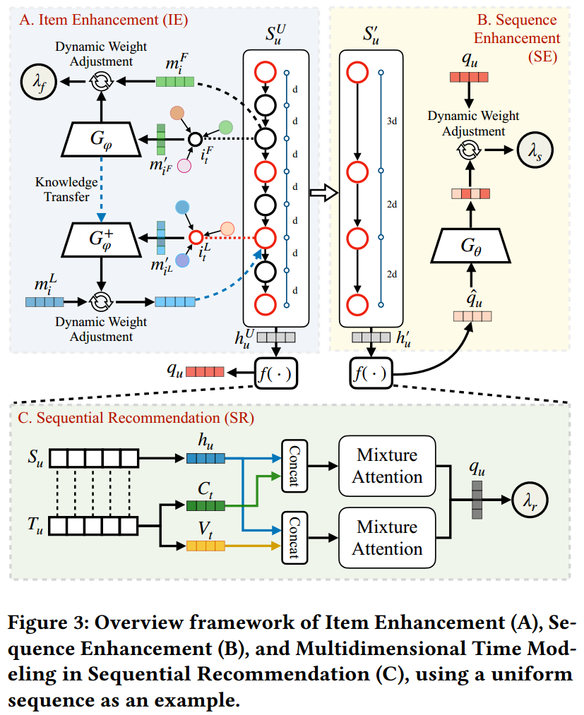
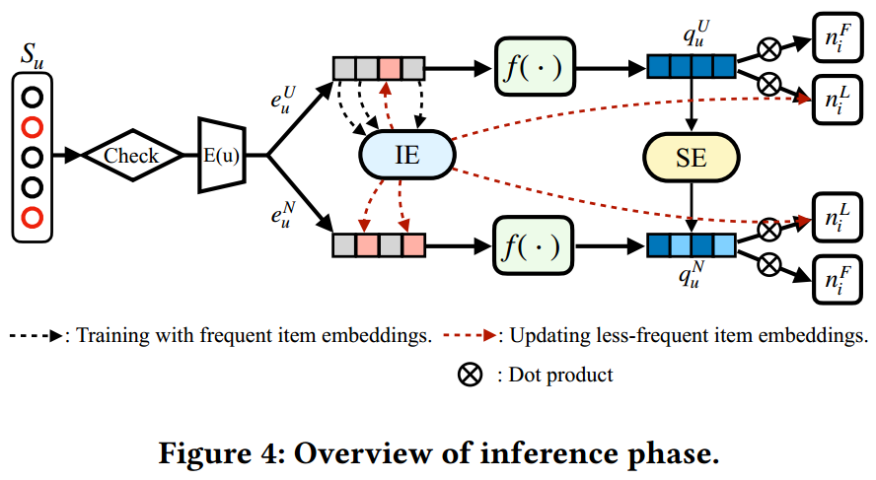
Method

Slide 5
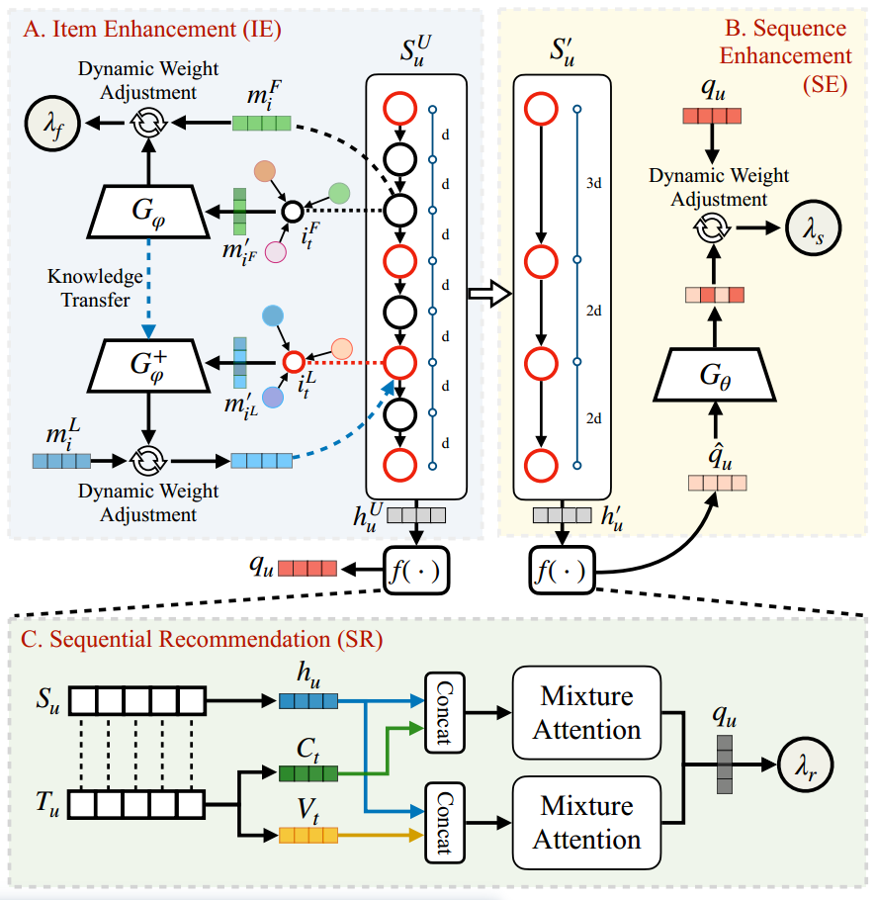
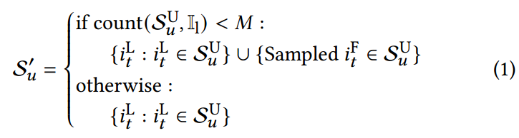


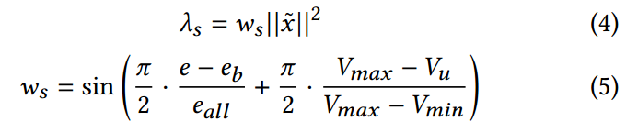
Method

Slide 6
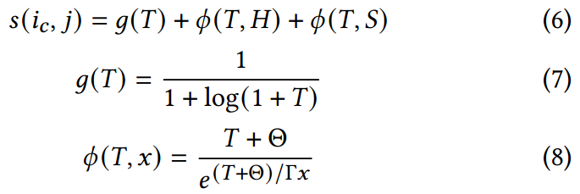
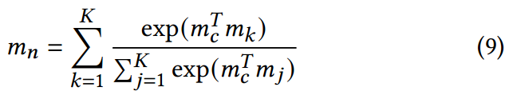

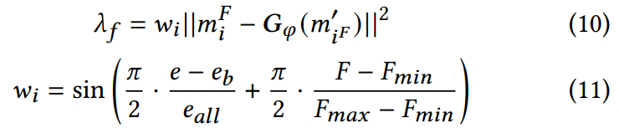
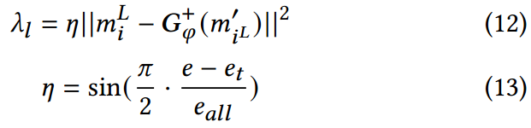
Method

Slide 7



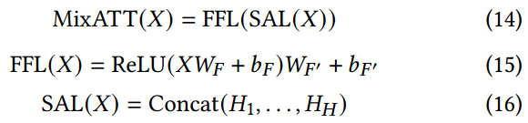



Method

Slide 8
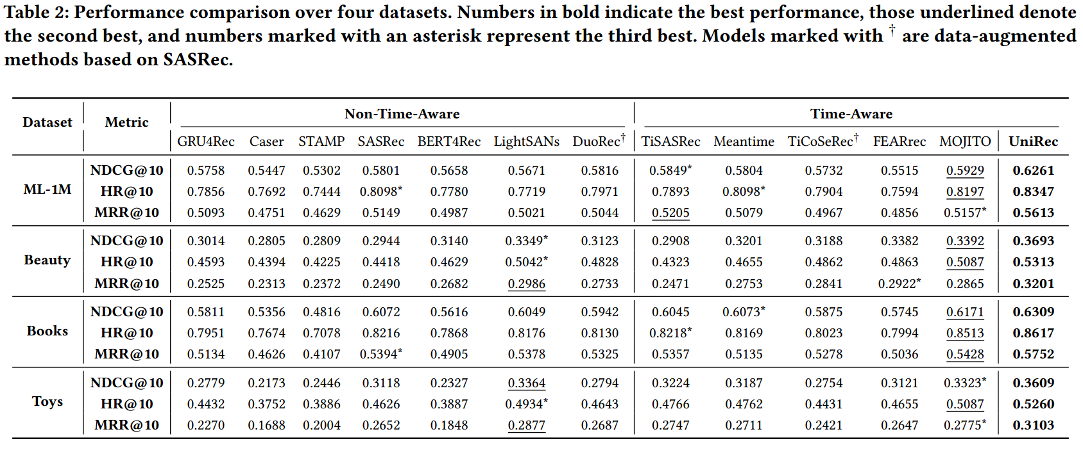
Experiments

Slide 9
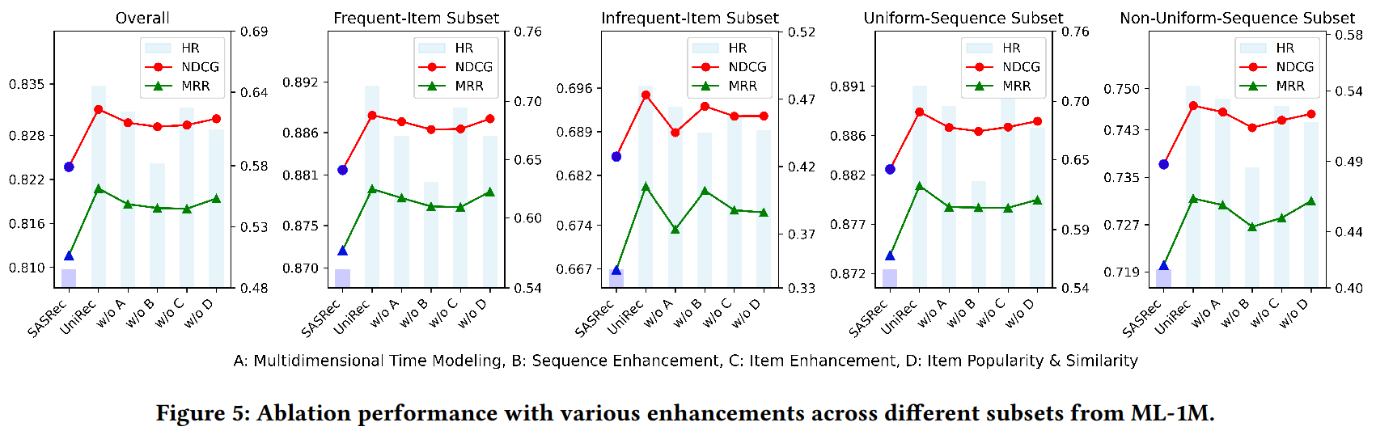
Experiments

Slide 10
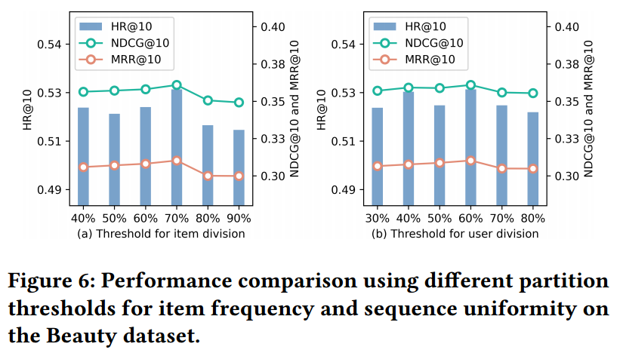
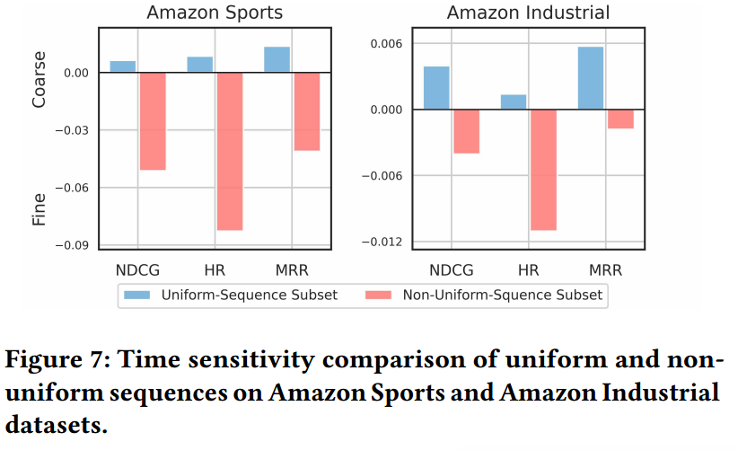
Experiments

Slide 11
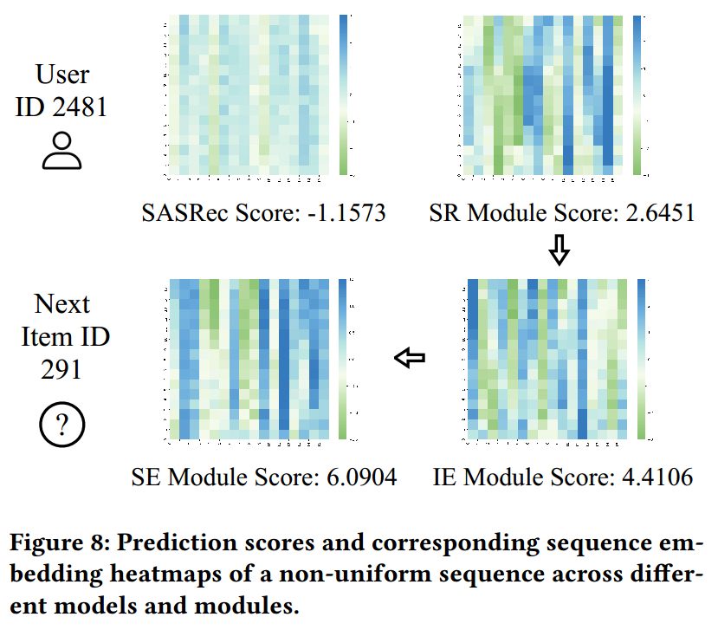
Experiments

Slide 12
Thanks!

